Slide 1
The Battle of Neighborhoods
Hong Kong vs Singapore: Where to open a restaurant/coffee shop?

Slide 2
Introduction -Hong Kong vs Singapore: Where to open a restaurant/coffee shop?
Hong Kong and Singapore, two of the major competitors in Asia economically, have been vying for the top spot in various global economic ranking indicators. To name a few:
Fraser Institute’s annual Economic Freedom of the World report, Hong Kong(1)and Singapore(2) are once again the most economically free jurisdictions in the world, occupying the top two spots.
IMD World Competitiveness Yearbook 2018, The United States returns to the first spot, followed by Hong Kong(2), Singapore(3), the Netherlands and Switzerland.
World Economic Forum's Global Competitiveness Report 2018, Singapore ranks 2nd while Hong Kong trails by 5 spots at 7th.

Slide 3
Problem
When it comes to a practical problem for a restaurant/coffee shop owner in any places of the world, when considering where to open a new business around the city center of these two places renowned for the ease of starting an operation, which city should he/she choose?

Slide 4
Data acquisition and cleaning
The data is acquired from Foursquare by collecting the information of 100 venues within the 500 meter-radius of the city centers of Central, Hong Kong and Downtown Core, Singapore
Only venues categorized as “restaurant” are selected to compare the variety of restaurants in both areas. To further explore the dominance of global coffee shop chain in both places, locations of Starbucks around the city centers are fetched also by using Foursquare

Slide 5
Exploratory Data Analysis and Results

Slide 6
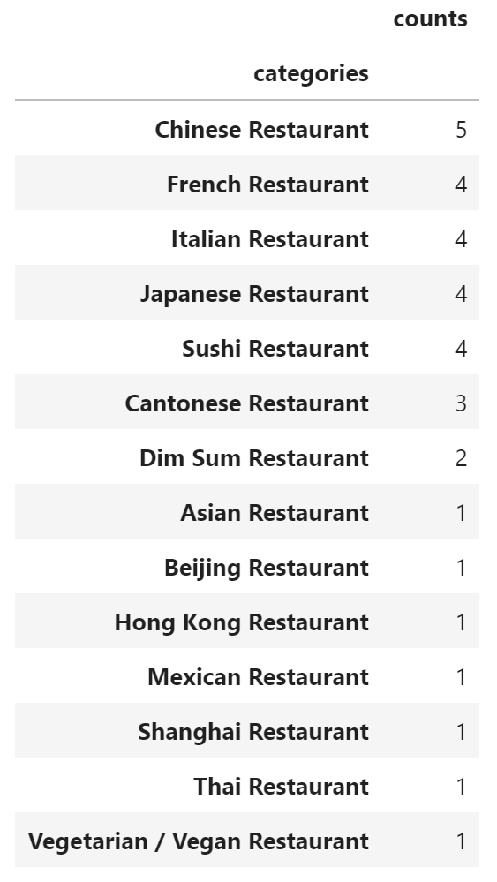
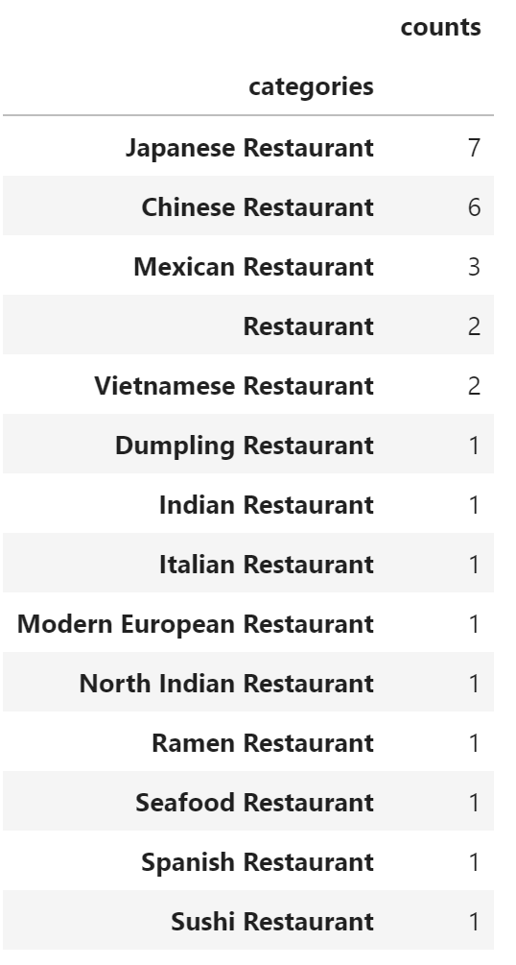
Which city offers more ethnic cuisines?
Hong Kong
Singapore
A city that placates a wide variety of tastes offers more flexibility for restaurant owners to formulate their business plans
Many of the items under Hong Kong can be categorized as Chinese Restaurants, such as ‘Cantonese’, ‘Beijing’, ‘Hong Kong’ and ‘Shanghai’ restaurants
Singapore offers more types of ethnic cuisines

Slide 7
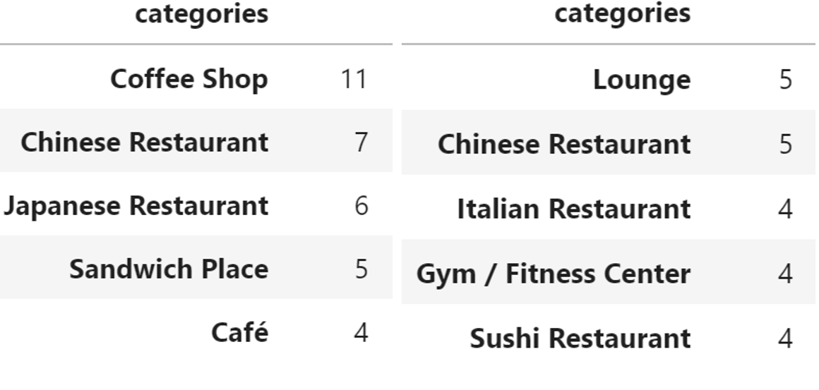
Which city is a better place to open a coffee shop?
Singapore
Hong Kong
Comparison of the Top 5 categories of venues in both cities
Singapore stands out with a large number of coffee shops

Slide 8
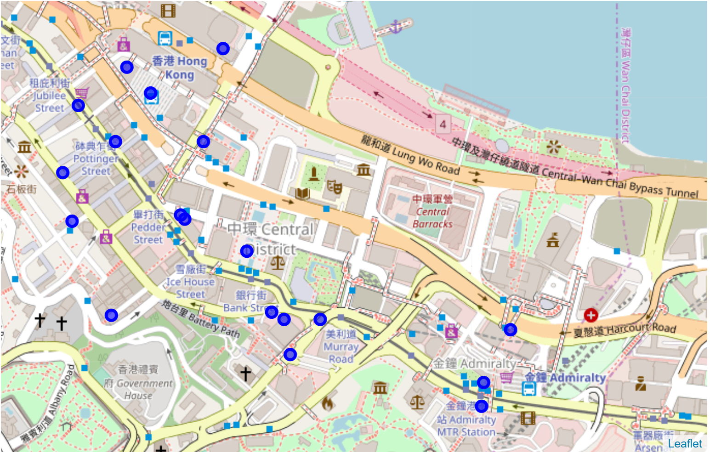
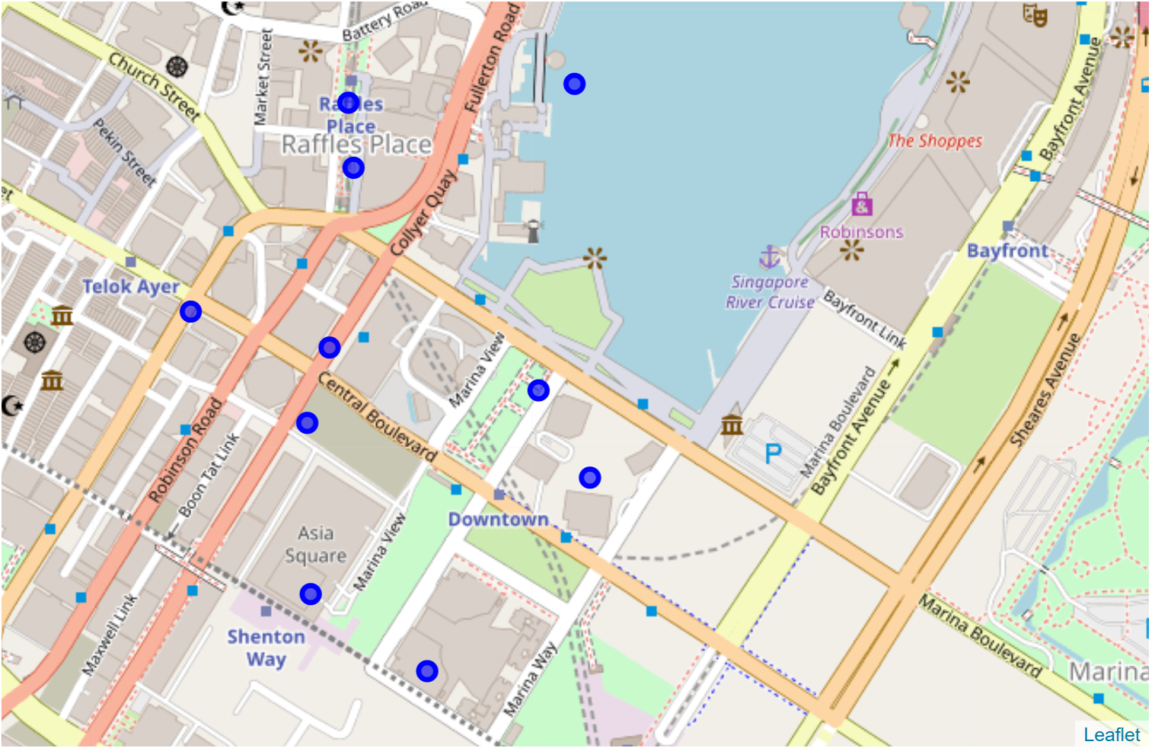
Factoring in the Starbucks effect
Location of Starbucks around Central, Hong Kong(top) and Downton Core, Singapore(bottom)
Number of Starbucks in Central, Hong Kong outnumbers Downtown Core, Singapore by 19 to 9

Slide 9
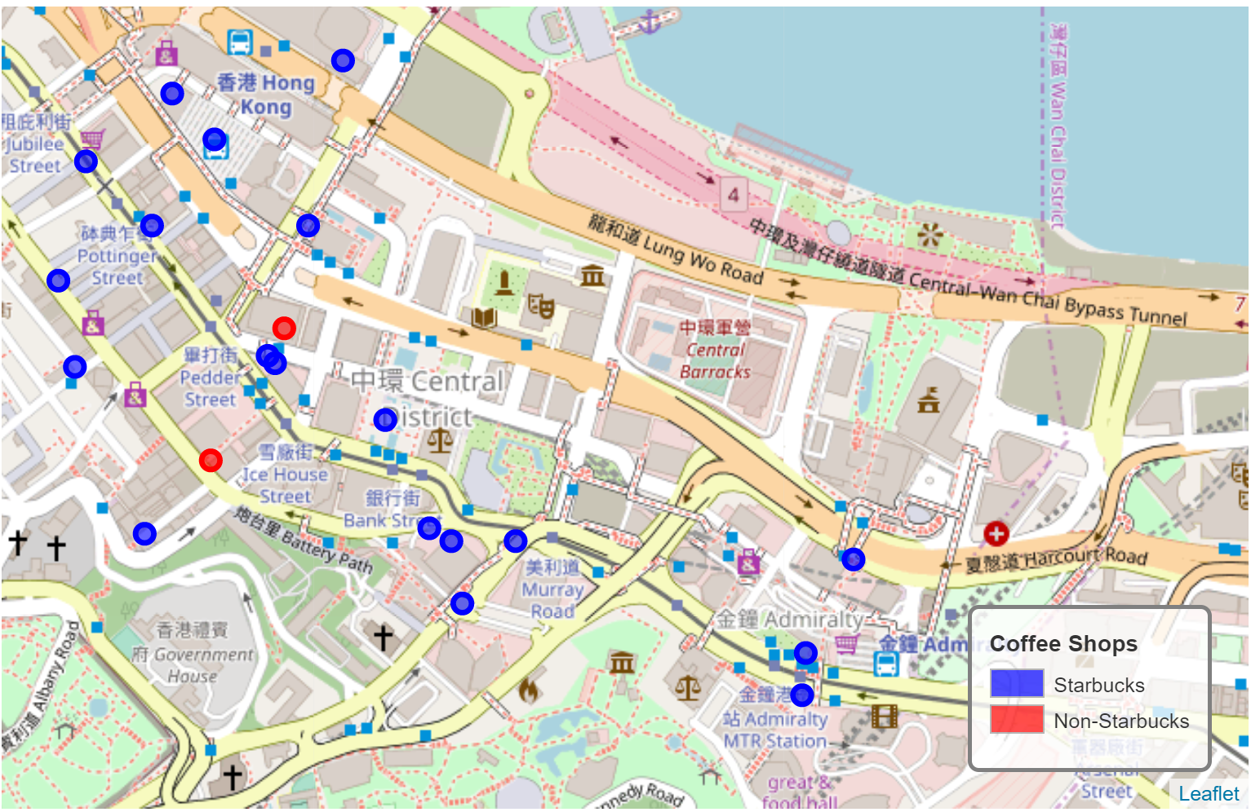
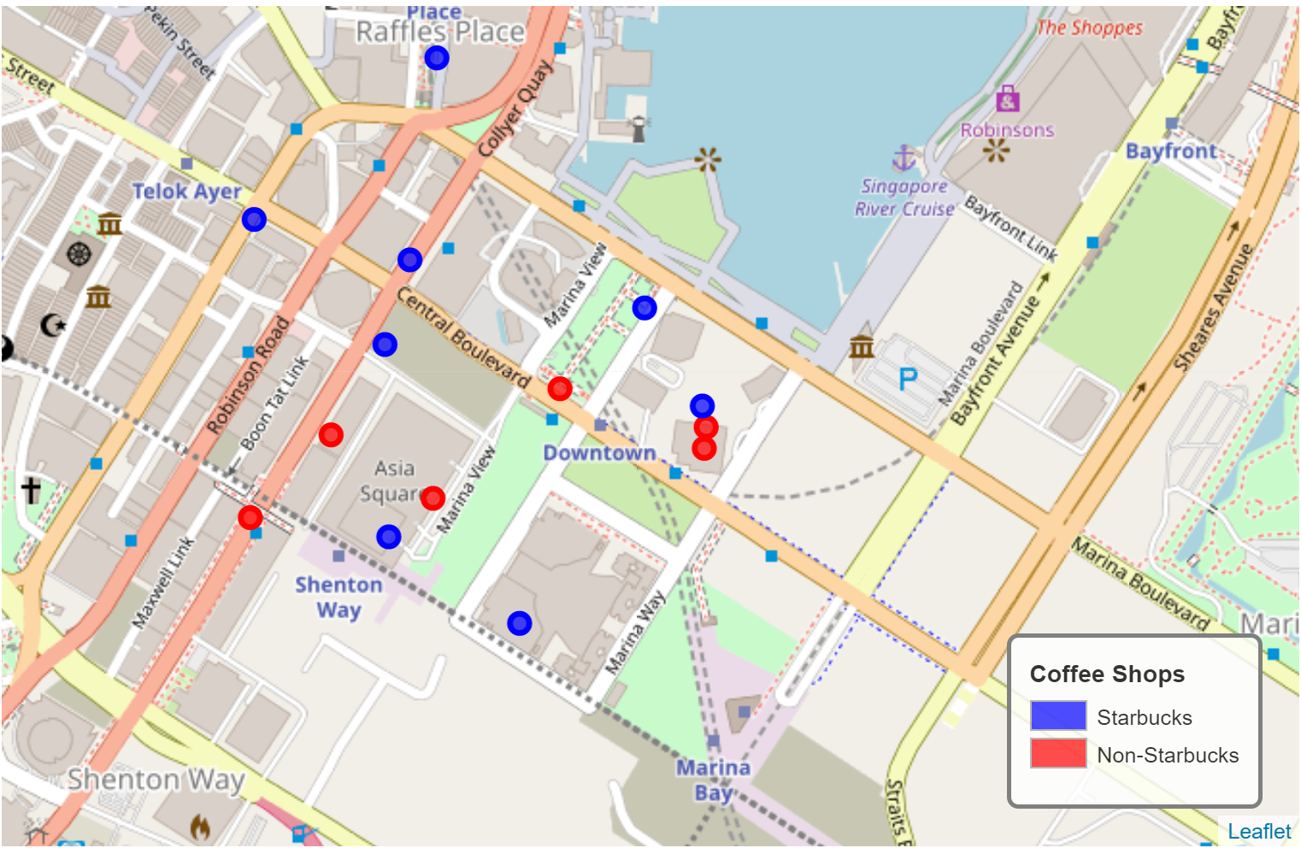
Considering Non-Starbucks coffee shops…
Location of coffee shops around Central, Hong Kong(top) and Downton Core, Singapore(bottom)
More non-Starbucks coffee shops around Downtown Core, Singapore. Many of them are closer to the city center than Starbucks

Slide 10
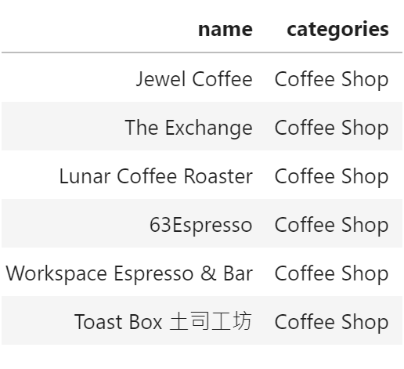
Non-Starbucks around Downtown Core, Singapore

Slide 11
Discussion and Conclusion
Singapore ticks both boxes for offering a wide selection of ethnic cuisines and better prospects for survival in face of dominance by Starbucks
High rents for shops in Hong Kong may account for the results, relevant data may be incorporated for further analysis
not fully representative of the coffee shop business in both cities (e.g. many non-Starbucks coffee shops can be spotted around Central within the Central and Western district)

